Slide 1

Machine Learning
Emne 3: Machine learning, algoritmer Af Lærke Brandhøj Kristensen
lkri@techcollege.dk

Slide 2
Agenda
Reggression
Classication
Clustering
Tekst og billede genkendelse
Kvaliteten af modeller
Træning og testing

Slide 3
Algoritmer i ML
Metoderne der bliver brugt til at lave en ML model
Paradimer Supervised, unsupervised, reinforcement, deep learning
Supervised
Regression
Classification
unsupervised
Clustering
Notes:
https://blog.bismart.com/en/classification-vs.-clustering-a-practical-explanation

Slide 4
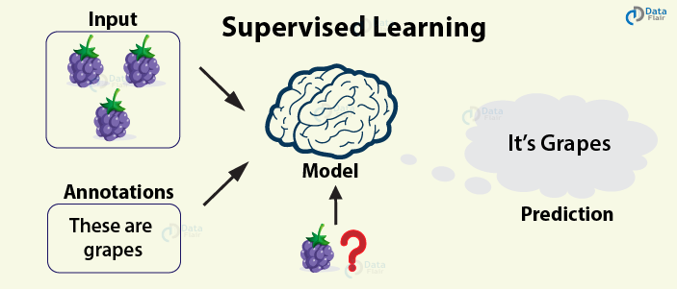
Supervised learning
Regression
Classification
Notes:
Billede: https://data-flair.training/blogs/types-of-machine-learning-algorithms/

Slide 5
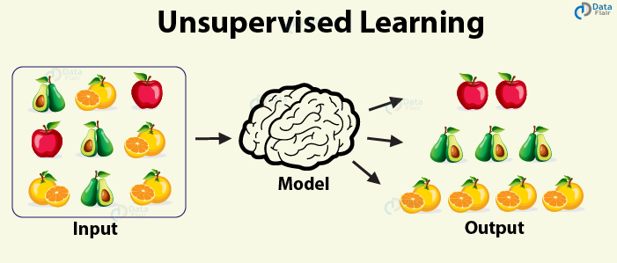
Unsupervised learning
Clustering

Slide 6
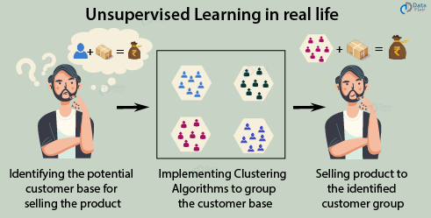
Unsupervised learning
Marketing
Notes:
Billede: https://data-flair.training/blogs/types-of-machine-learning-algorithms/

Slide 7
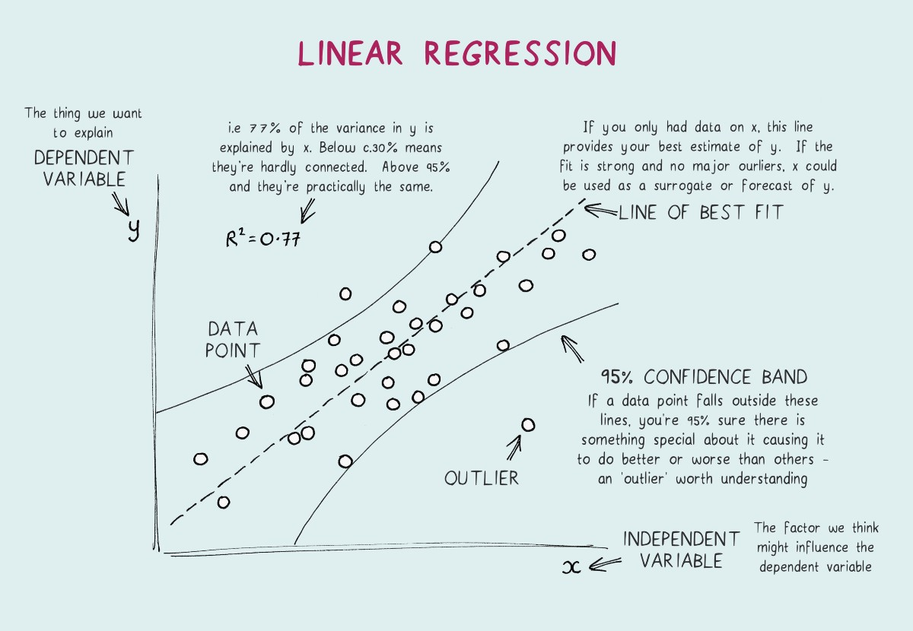
Regression
Supervised learning
Reggression er en general linjear model
Data = Model + Error
Eksempler
Risiko vurdering
Score forudsigelse

Slide 8
Clustering
Unsupervised learning
Hård og blød clustering
True/false eller sandsynlighed
Eksempler
Målrettet marketing
By planlægning
Recommendation systemer
Sociale networks analyser
Grupering af søge resultater
Medisinsk billed genkendelse
Anomalier (predictive maintenance)
Notes:
https://www.analyticsvidhya.com/blog/2016/11/an-introduction-to-clustering-and-different-methods-of-clustering/ Hard Clustering: In hard clustering, each data point either belongs to a cluster completely or not. For example, in the above example each customer is put into one group out of the 10 groups.
Soft Clustering: In soft clustering, instead of putting each data point into a separate cluster, a probability or likelihood of that data point to be in those clusters is assigned. For example, from the above scenario each costumer is assigned a probability to be in either of 10 clusters of the retail store.
https://www.analyticsvidhya.com/blog/2016/11/an-introduction-to-clustering-and-different-methods-of-clustering/
Andre typer clustering: k-mean, hierarchical

Slide 9
Classification
Supervised learning
Eksempler
Email spam detection
Diagnosering
Svindel detection
Billede klassifisering
Notes:
Gif: https://blog.bismart.com/en/classification-vs.-clustering-a-practical-explanation

Slide 10
Tekst og billede genkendelse
Billeder og tekst er rigtig svært for maskiner og forstå.
Navie bayes
Deep learning

Slide 11
Model chains
For at udregne encodning på datasæt og få nogle true/false værdier ud af complexed data.
Det kan man bruge til at lave en række af modeller som hjælpe med at forme datasættet, sådan at den sidste model som kan løse problemet.
Clustering til at hjælpe supervised learning med at blive mere præsis.
Notes:
https://www.analyticsvidhya.com/blog/2016/11/an-introduction-to-clustering-and-different-methods-of-clustering/
Clustering is an unsupervised machine learning approach, but can it be used to improve the accuracy of supervised machine learning algorithms as well by clustering the data points into similar groups and using these cluster labels as independent variables in the supervised machine learning algorithm?

Slide 12
Kvaliteten af modeller
Der er vigtigt at teste modellerne som bliver trænet
Iterativt
Lav test ved at dele data’et op i test og trænings data.
Generalisering
Modeller der testes godt på data den aldrig har set før er god til at generalisere.
Notes:
https://www.youtube.com/watch?v=-vHQub0NXI4

